Slide 1
“Market coupling on the Italian border: results and lessons from the Italy-Slovenia coupling, update on the PCR project”
Electricity Regional Initiative – Central South region 4th Stakeholder Group meeting
Rome, May 15th 2012

Slide 2
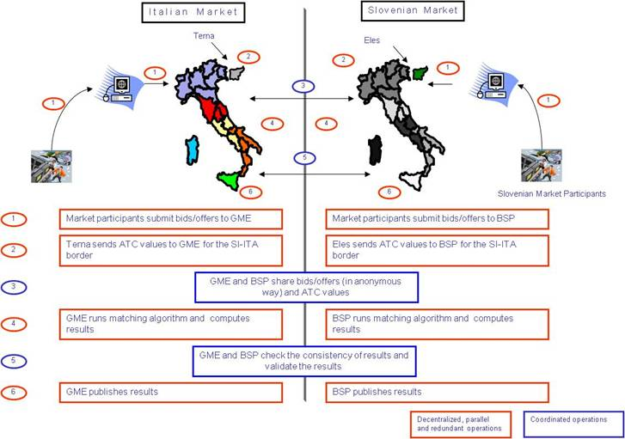
The pilot project on the Italian – Slovenian border A fully decentralized approach

Slide 3
Market coupling outcomes since 1/1/2011 Traded volumes growth
Strong liquidity growth on BSP and on the implict auctions
Strong increase in volumes allocated through mkt coupling in addition to the reserved share (35 MW)

Slide 4
Market coupling outcomes since 1/1/2011 Price convergence
Some increase in frequency of price convergence, considering an higher price difference in average during first four-month 2012
The rare occasions of negative price differentials (ITp<SLp) has become price indifference cases

Slide 5
Market coupling outcomes since 1/1/2011 Efficient capacity allocation
In 2011 implicit auction guaranteed efficient allocation and occasional commercial export, while explicit auction always allocated in import.
In 2012 explicit auction efficiently exported in 9% of hours of price indifference

Slide 6
Lessons learnt/1
Coupling with illiquid markets
The growth of traded volumes on BSP confirms mkt coupling scheme as a natural liquidity provider, which has the potentiality to make benefit to illiquid markets from X-border liquidity. The overall efficiency of capacity allocation are so guaranteed also in this case.
Short term flexibility
The growth of volumes allocated with respect to the quota reserved to mkt coupling and its peak in january, also due to the entry into force of new delivery contracts, evidences the preference of market participants for the flexibility granted by the daily implicit nomination scheme and the chance for them to efficiently use UIOSI clauses, as financial contracts to fix the price received.
Effectiveness also in wide price differential borders
The increase of the percentage of hours in which the X border prices converge is an expected beneficial outcome, with an outstanding 20% of hours with the same price during 2011.
Price differential rarely changes sign due to the small dimension of the slovenian DAM market, whose demand on the market is generally lower than import capacity.
Implicit auction allocates capacity in import much more frequently than explicit auction, especially in the hours of price convergence.

Slide 7
Lessons learnt/2
The benefits of a decentralized solution
The governance and operational solution for the Italian Slovenian Border reflects the PCR decentralzied approach
This enabled a faster delivery of a reliable market coupling solution between two countries with different institutional and governance frameworks.
The need of a stable framework for post coupling arrangements
The benefits of market coupling calls for great market volumes, independently from the quota of capacity reserved to market coupling. This calls for stable and sustainable shipping arrangements between the involeved parties.

Slide 8
The PCR project update General concepts
PCR provides coupling solution for the EU market
Supported by all the European PXs through Europex
Accepted by ACER and EntsoE to support the start up of NWE coupling
Regularly presented and debated at the AESAG, Florence and NWE fora.
PCR is a decentralized solution
In PCR one Coordinator PX runs the coupling algorithm, one Back-Up Coordinator PX provides hot back up service, both on a rotational basis. Other PCR PXs can run shadow auctions with same inputs and tools to check the validity of the results.
Each PX in the EU can decide wether to be:
a PCR party entering in the rotation for Coordinator/HorBackUp
a PCR party only running shadow auctions to validate its prices (PCR Operator)
a PCR party subcontracting its operational performance to another PCR Party
a serviced PX by a PCR member
Each PX is responsibile for its own DAM prices.

Slide 9
The PCR project update PCR assets
Algorithm
One single price coupling algorithm encompassing the features of NWE, Mibel, Italy-Slovenia and open to embody further EU requirements
Cosmos longely selected as starting point, validation from EntsoE expected
Development of a prototype, including MIC and PUN features, nearly concluded
Industrialization phase to start in May.
System design
PBM (PCR Broker& Matcher) supports the decentralized coupling approach by collecting, validating and exchanging the inputs (bids, ATCs, PTDFs) and the outputs (p, q, net positions, flows).
Design phase finalized, provider selected and industrialization phase to start in May.
Governance
Cooperation & Coownerhsip agreements nearly approved.
Agreements consistent with the EU Draft Governance Guidelines.

Slide 10
The PCR project update State of advancement
Delivery of PCR assets and PX testing by september 2012, in order to go live on January 2013.
This refers to coupling solution, as provided by PCR. To couple, pre/post coupling arrangements must bealso agreed, either on a border by border basis or based on common agreed regional approach.
Integration Test for Regional Initiatives will start on 1st October 2012, to be ready to go live by Januray 2013.
They will include the TSOs.
Finalization of pre/post coupling arrangements required.
GME will take part only for the technical test, as Italy will not be coupled by such date.

